Slide 1
Entrepreneurship BS-CS – 2021 – Fall Semester
Salmaan Rahman
Lecture 3
Business Opportunity Assessment

Slide 2


Slide 3
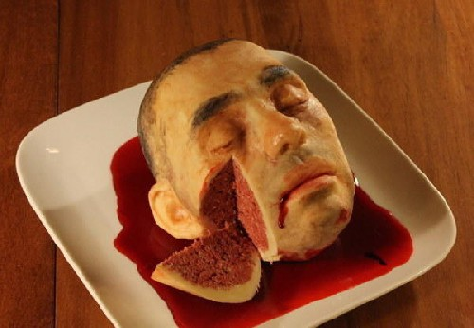
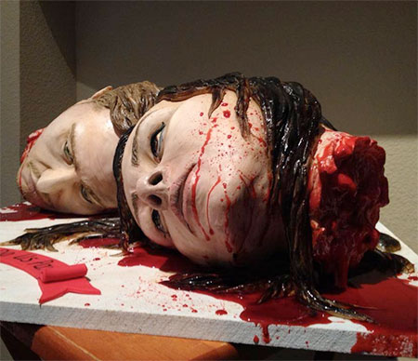

Slide 4

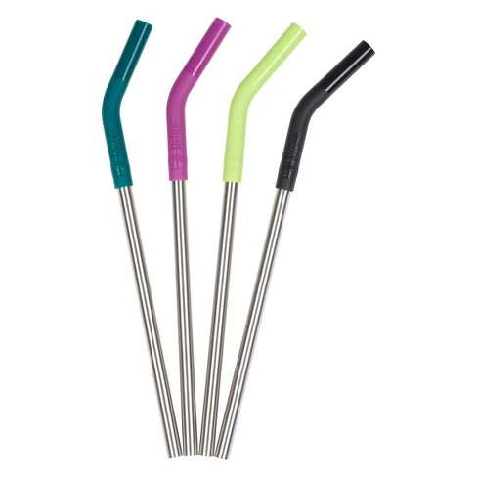
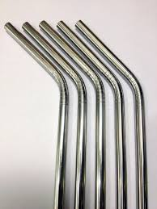

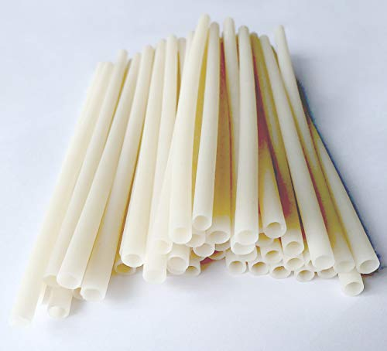

Slide 5


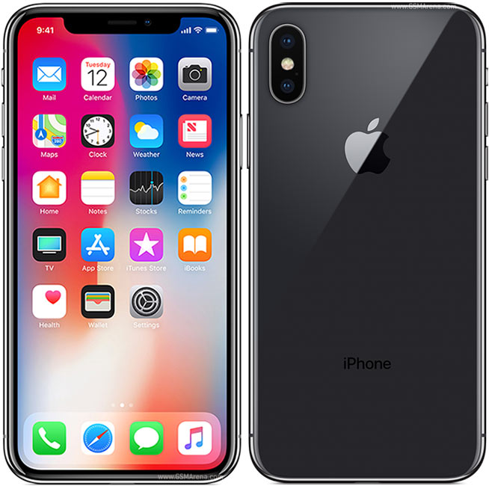

Slide 6
Opportunity:
An opportunity is a favorable set of circumstances (in our environment) that creates a need for a new product, service or business
An idea is a thought, impression or notion
Not all ideas meet the criteria for an opportunity
It is crucial to understand whether your idea fills a need and meets the criteria for an opportunity
Opportunities have windows: - the time period when a when a new business can most realistically enter the market
The window of opportunity closes as the market matures

Slide 7
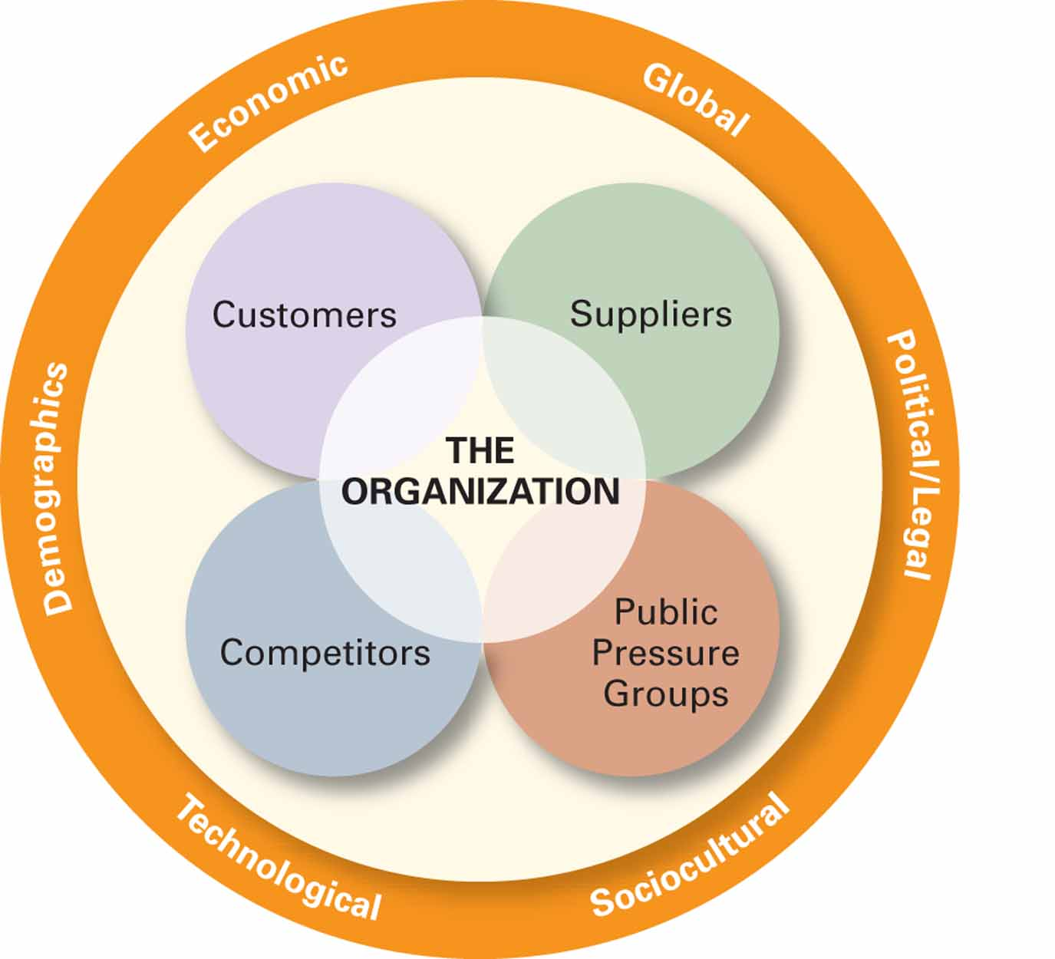
External Environment

Slide 8
Identifying Opportunities
Three ways to identify opportunities
Observing trends
Solving a Problem
Finding gaps in the marketplace

Slide 9
Finding Opportunities - Trends; Observing Trends
Economic Trends
Social Trends
Demographic
Technological advances
Political action / Regulatory changes
Global
What is the difference between a “trend” and a “fad”?

Slide 10
A market trend is a prevailing course or tendency of a market to move in a particular direction over time.
A fad is a short term movement
Small businesses cannot ramp up to fast enough to take advantages of fads

Slide 11
Finding Opportunities - Trends: Economic Trends:
Economic forces: the state of the economy affects level of disposable income and spending patterns
More people start businesses in weak economies than strong economies
Weak economy: provides opportunities for money saving businesses (e.g Groupon, local markets)
Strong economy will provide opportunities for luxury, non-essential, or convenience products

Slide 12
Finding Opportunities - Trends: Social Trends:
Often, the reason a product or service exists is because of a social need rather than the obvious need
Fast food restaurants – time saving
Social media – connection and communication
Social trends:
Health, wellness and fitness
Ageing and changing demographics
Biofuels and environmental concerns
Higher education requirements for basic jobs
Healthy (organic, non-GMO) foods and supplements

Slide 13
Finding Opportunities - Trends: Technological Advances:
Advances in technology frequently interacts with social and economic trends – most often to make it easier for people to do regular tasks in a more convenient fashion
E.g: health and fitness -> tech and app development (Fitbit)
This means that the key to recognizing opportunities in the tech field is to recognize how technology can be harnessed to satisfy social or economic needs (e.g. OpenTable.com)
Once a technology is established, products emerge to support and advance it
MP3 files -> MP3 Players

Slide 14
Finding Opportunities - Trends: Political and Regulatory Changes:
New laws create new opportunities
Individual
Business to business
Political issues may include things like
Terrorism
Including cyber terrorism
Safety issues
Tariff, import-export laws
Regulations on technology, internet usage, social media etc
Censorship

Slide 15
Opportunities – Solving Problems:
The second approach to identifying opportunities is to recognize a problem and find ways to solve them.
Problems are
Challenges faced by people in regular life
Problem faced by you
Changes in the environment
Technological, social
Many problems already have solutions on the market
Finding ways to make the solutions easier, cheaper, more efficient or effective

Slide 16
Opportunities – Gaps in the market
Gaps are created when consumers need or want particular products which are either difficult to obtain, or unavailable leading to frustration
Global changes can create huge gaps
Growth of large retailers can create a need for specialty shops
Niche markets – e.g gender based, interest based

Slide 17
Opportunity recognition Entrepreneur Characteristics
Prior experience / knowledge, field of expertise / training
Working within, or starting a business opens up new, and sometimes unexpected venture opportunities – “corridor principle”
Cognitive Factors
Sixth sense, entrepreneurial alertness
Learned skill. . . Prior knowledge helps
Social Networks
“Strong tie” vs. “Weak tie” relationships
New ideas come more frequently from “weak tie” relationships
Creativity

Slide 18
Idea Generation
Reading widely – Library and Internet research
Brainstorming
Focus Groups

Slide 19
Starting a new business
On average, about 600,000 new businesses are started every year (USA)
1,500 per day
Ideas for potential new businesses are also very high
375,000 patent applications per year
However, many businesses fail within the first year

Slide 20
Pitfalls in selecting new Ventures
Lack of objective evaluation
Falling in love with an idea for a product or service
Lack of scrutiny – assumption that if it makes sense to the person it will be appreciated by everyone else
Can be avoided by subjecting ideas to rigorous study and investigation
Lack of Insight into market
No product is immediately profitable, nor indefinitely successful
Developing the right marketing approach is vital
Understanding marketing forces
Right timing, right placement etc.
Knowing about factors like product life-cycles etc. can be critical

Slide 21
Pitfalls
Inadequate understanding of technology, technical requirement
New product development often requires new techniques
Unanticipated technical difficulties increase costs and time
Poor financial understanding
New entrepreneurs often underestimate costs and liabilities
Lack of venture uniqueness
The key to success is often product differentiation
Ignorance of legal issues.
Lack of a workable strategy

Slide 22
New Venture Checklist
Basic questions:
Will the new product or service work?
Is it legal?
Competitive Advantages:
What competitive advantage can you offer?
What are the competitive advantages of the competitors?
Similar products
Substitutes
How are competitors likely to respond?
How will you maintain competitive advantage?

Slide 23
Checklist
Who are the customers likely to be?
How much will they buy? How often?
Where are they located? Customer availability
Marketing
How much do you need to spend to create initial awareness? How much to maintain awareness?
Who will do the selling?
How will you set prices?
Location, distribution channels etc.
Sales targets

Slide 24
Checklist
Production
Make by self or outsource?
Are supplies readily available?
Delivery time, restocking etc.
Premises – location, size, etc.
Quality control
Staffing decisions
Who, what, when?
Controlling:
Record keeping, goal setting, evaluation

Slide 25
Checklist
Financing
How much is needed for
Development
Production / Operations
New staff
Marketing and sales
Working capital
Where will the money come from?
Where is additional money going to come from?
Further loans
Self-generated – initial sales

